Slide 1
Hierarchical Regression
Modeling
Theory-Driven Sequential Analysis & Interaction Testing
1

Slide 2
What We'll Cover
01
What is hierarchical regression?
05
Interaction patterns & simple slopes
02
Block structure & the F-change test
06
Johnson-Neyman & regions of significance
03
Why interaction terms are essential
07
Common errors to avoid
04
Centering & forming products
2

Slide 3
What Is Hierarchical Regression?
Hierarchical regression builds a model in a theoretically driven sequence of steps ("blocks"), allowing researchers to assess the unique contribution of each predictor set after controlling for earlier ones.
Key statistic
ΔR²
Hierarchical
Theory-driven order of entry
ΔR² at each step is interpretable
Controls confounds before focal predictors
Change in variance explained
by the new block, over and above
all previously entered blocks.
Stepwise
Tested with the F-change statistic
Data-driven order (avoid!)
No theoretical basis
Inflates Type I error
3

Slide 4
Building the Model: Block Structure
Block 1
Block 2
Block 3
Control variables
Focal predictors
Interaction terms
Age, SES, prior ability
X₁, X₂ (main effects)
X₁×X₂, X₁×X₃
ΔR²1
ΔR²2
ΔR²3
Ŷ = b₀ + b₁(ctrl₁) + b₂(ctrl₂)
Ŷ = … + b₃(X₁) + b₄(X₂)
Ŷ = … + b₅(X₁ × X₂)
4

Slide 5
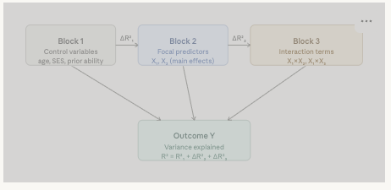

Slide 6
Why Interaction Testing
Is Essential
The most consequential — and most frequently omitted — step
5

Slide 7
The Central Question of Moderation
Does the effect of X₁ on Y depend on the level of X₂?
!
Misinterpreted
main effects
!
Wrong policy
inferences
!
Distorted effect
estimates
Main effects may be averages masking opposite effects in different subgroups.
Interventions may appear uniformly effective when effects are conditional.
Omitting a true interaction suppresses or inflates the size of main effects.
If moderation is theoretically plausible, it MUST be tested. A non-significant ΔR² is also informative — it rules out moderation.
6

Slide 8
Centering Before Forming Interaction Products
Step 1
Step 2
Step 3
Compute the mean of X₁
M(X₁) = sample mean
Center: X₁c = X₁ − M(X₁)
X₂c = X₂ − M(X₂)
Form product term
X₁c × X₂c → enter as Block 3
Why centering matters:
Reduces multicollinearity
Interpretable main effects
The product X₁c×X₂c correlates far less with X₁c and X₂c than the uncentered product correlates with the raw predictors.
After centering, b₃ and b₄ represent the effect of each predictor at the mean of the other — a meaningful reference point.
Stable standard errors
No change to fit statistics
Uncentered products inflate VIFs dramatically, widening confidence intervals and reducing power to detect the interaction itself.
Centering does not alter R², ΔR², F-change, or the interaction coefficient — only the interpretation of lower-order terms.
7

Slide 9
Testing ΔR²: The F-Change Statistic
F =
( ΔR² / Δdf )
( 1 − R²full ) / ( N − k − 1 )
Formula components:
What to look for
Δdf
Number of new predictors added (usually 1 for a single two-way interaction)
p < .05
R²full
R-squared from the full model with all predictors
Interaction term adds meaningful variance beyond main effects. Proceed with full interaction model and probe simple slopes.
N
Total sample size
p ≥ .05
No significant moderation detected. Report the main-effects-only model. An insignificant ΔR² still rules out moderation.
k
Total number of predictors in the full model
8

Slide 10
Four Canonical Interaction Patterns
Ordinal (synergistic)
Disordinal (crossover)
Lines don't cross. X₂ amplifies X₁'s effect — direction is the same at all levels.
Lines cross. Effect of X₁ reverses across levels of X₂.
e.g. — High-resource students benefit more from tutoring than low-resource peers.
e.g. — Structured instruction helps low-prior-knowledge students but harms high-knowledge students.
Buffering (attenuation)
Fan-spread
X₂ weakens or eliminates X₁'s effect. Common in resilience research.
Lines converge at low X₁, diverge at high X₁. Ubiquitous in test score data.
e.g. — Social support buffers the negative effect of stress on academic performance.
e.g. — Achievement gaps widen as instructional intensity increases.
9

Slide 11
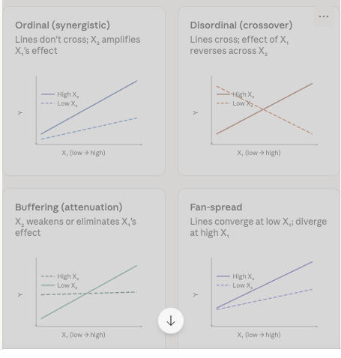

Slide 12
Simple Slopes: Probing a Significant Interaction
After fitting the full model, compute predicted values of Y at combinations of X₁ and X₂ levels (typically ±1 SD). Plot the result as a family of regression lines — one per level of X₂.
Simple slope equations:
Testing each simple slope
High X₂ (+1 SD)
Each simple slope has its own t-test and confidence interval. A visually dramatic fan pattern may not reach significance with small N — always test formally.
Slope = b₁ + b₅(+1) = b₁ + b₅
Mean X₂ (0)
Slope = b₁ + b₅(0) = b₁
Interpreting main effects with a significant interaction
Low X₂ (−1 SD)
Slope = b₁ + b₅(−1) = b₁ − b₅
Once the interaction is significant, b₃ and b₄ describe each predictor's effect only at the mean (zero) of the other — not as a simple "average" effect. Interpret with caution.
10

Slide 13
Beyond ±1 SD: The Johnson-Neyman Technique
The Johnson-Neyman (J-N) technique identifies the exact values of X₂ at which the simple slope of X₁ transitions from statistically significant to non-significant — without relying on arbitrary cut-points.
Pick-a-point (±1 SD)
Johnson-Neyman
Advantages
Advantages
Familiar and widely reported
Easy to visualize
Finds exact significance boundary
Provides region of significance in X₂ units
Covers the full distribution of X₂
Limitations
Arbitrary cut-points
May miss boundaries within the distribution
Requires separate tests per point
Limitations
Less intuitive to non-specialists
Output can be complex to present
11
Software: interactions package (R) | PROCESS macro (SPSS/SAS) | Both compute J-N regions and produce floodlight graphs automatically.

Slide 14
Common Errors to Avoid
01
Skipping the interaction test entirely
04
Inadequate sample size
Many published studies stop at Block 2. If moderation is theoretically possible, it must be tested.
Detecting interactions needs 4–8× the N required for equivalent main effects (McClelland & Judd, 1993). N < 200 warrants concern.
02
Interpreting main effects when interaction is significant
05
Relying on the plot without formal slope tests
With a significant interaction, b₃ and b₄ describe effects only at the mean of the other predictor — not average effects.
A visually striking fan-spread may not be statistically significant. Always supplement plots with t-tests or CIs for each simple slope.
03
Forgetting to mean-center
Uncentered products create extreme multicollinearity, inflate SEs, and make main-effect coefficients nearly uninterpretable.
12

Slide 15
Key Takeaways
Hierarchical Regression & Interaction Testing
13

Slide 16
Key Takeaways
→
Theory drives block order
c
Center before you multiply
Controls → main effects → interactions. ΔR² quantifies each block's unique contribution.
Mean-centering both predictors before forming the product reduces multicollinearity and keeps main effects interpretable.
×
Always test the interaction
~
Plot and test simple slopes
A main-effects-only model assumes parallel slopes. This assumption must be tested, not assumed.
Supplement every significant interaction with a simple slopes graph AND formal t-tests or confidence intervals.
J
Use J-N for precision
N
Power matters enormously
The Johnson-Neyman technique identifies exact regions of significance without relying on arbitrary ±1 SD cut-points.
Interactions require far larger samples than main effects. Plan accordingly — N < 200 is typically insufficient.
13

